Slide 1

Group 3
Elliot Chester, Adam Speers, Matt Fisher, Lenneth Dayaon

Slide 2

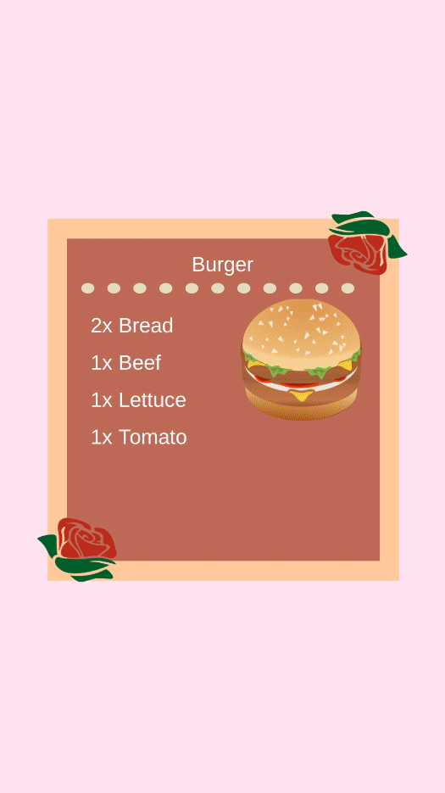
Our Game
2D Cooking Game
Symmetrical
Turn Based Competitive
Cognitive Memory Gameplay
Notes:
This will include our prototype and just a few words to describe it

Slide 3
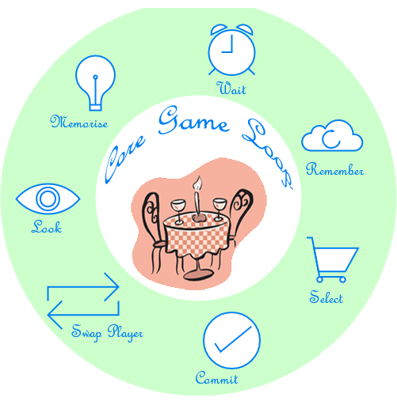
Core Game Loop
Notes:
This will include our prototype and just a few words to describe it

Slide 4

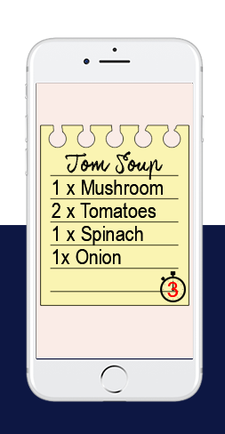
The emotions we aim for
Hard Fun
Fiero
People Fun
Schadenfreude
Stroop effect
Notes:
Maybe have videos/ pictures of player wins and player interaction
Describe them

Slide 5
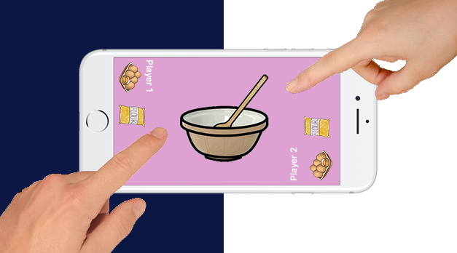
The emotions we aim for
Hard Fun
People Fun
Play with friends
Schadenfreude
Stroop effect
Notes:
Maybe have videos/ pictures of player wins and player interaction
Describe them

Slide 6
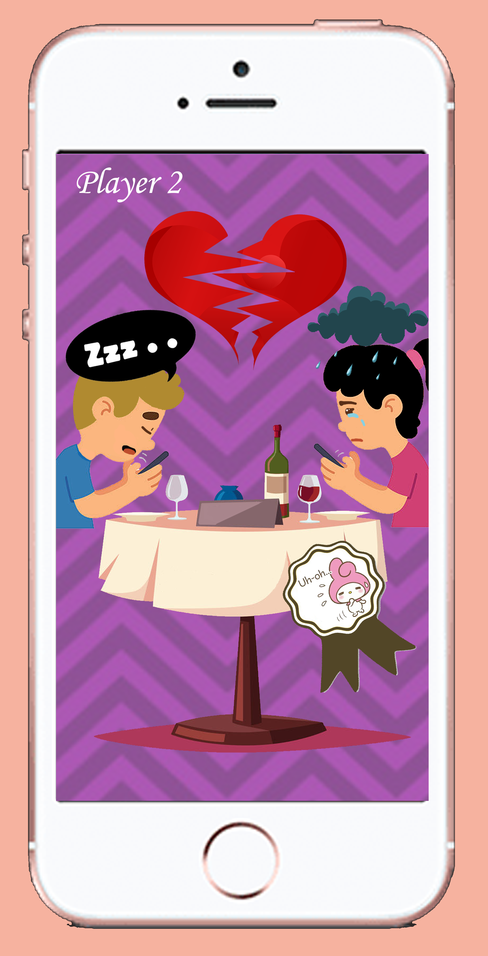
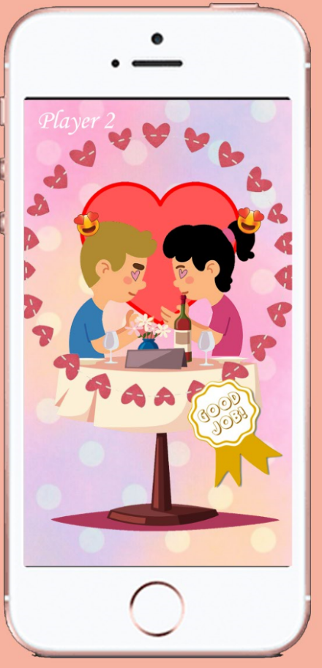
The emotions we aim for
Hard Fun
People Fun
Schadenfreude
Beat your opponent
Stroop effect
Notes:
Maybe have videos/ pictures of player wins and player interaction
Describe them

Slide 7
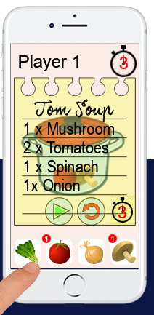
The emotions we aim for
Hard Fun
People Fun
Schadenfreude
Stroop effect
Given Text, Tap Pictures
Notes:
Maybe have videos/ pictures of player wins and player interaction
Describe them

Slide 8

The emotions we Got
Focused
Schadenfreude
Distracted
Confused
https://youtu.be/18fnsBOoD9k
Notes:
Maybe have videos/ pictures of player wins and player interaction
Describe them

Slide 9
https://youtu.be/18fnsBOoD9k
Notes:
Maybe have videos/ pictures of player wins and player interaction
Describe them

Slide 10

Key Programming Lessons
Don’t hard code things
Make everything as simple as possible
Working in the same project simultaneously causes issues
Notes:
Feedback from play testers, what to add, what to take away

Slide 11
Key Design Lessons
High contrast for interactive screen elements
Adding disruptors into flow of gameplay to increase difficulty
Give players different challenges to make game symmetric over time.
Providing indicators to players dependant on who wins
Notes:
Feedback from play testers, what to add, what to take away

Slide 12
Key Management Lessons
Communication is good
It’s easy to over scope
Ensure everybody has the same version of software
Make sure everybody has access to the latest build of the game
Notes:
Feedback from play testers, what to add, what to take away

Slide 13
Iterations
Player 2 could see the recipe twice and get an advantage
Players got bored and found it too easy
Introduction of player feedback loops
Notes:
Feedback from play testers, what to add, what to take away

Slide 14
Iterations
Player 2 could see the recipe twice and get an advantage
Each Player has a different recipe
Players got bored and found it too easy
Introduction of player feedback loops
Notes:
Feedback from play testers, what to add, what to take away

Slide 15
Iterations
Player 2 could see the recipe twice and get an advantage
Each Player has a different recipe
Players got bored and found it too easy
We reduced the time per turn
Introduction of player feedback loops
Notes:
Feedback from play testers, what to add, what to take away

Slide 16
Iterations
Player 2 could see the recipe twice and get an advantage
Each Player has a different recipe
Players got bored and found it too easy
We reduced the time per turn
Introduction of player feedback loops
We showed players if they have the right ingredients
Notes:
Feedback from play testers, what to add, what to take away

Slide 17
What we could do with more time
Finish the results screen
Add the couple screens into the game
Add more levels – themed recipe packs
Discussed the flow of gameplay
Implement disruptors
Notes:
Feedback from play testers, what to add, what to take away

Slide 18
Any Questions?

